Slide 1
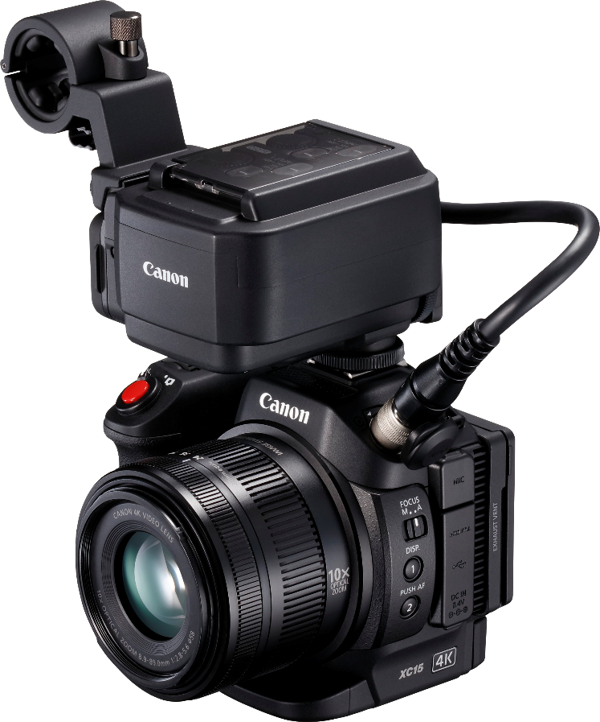
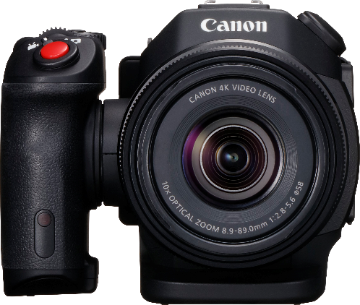
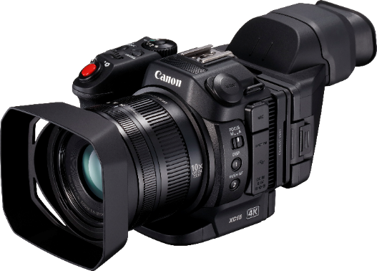
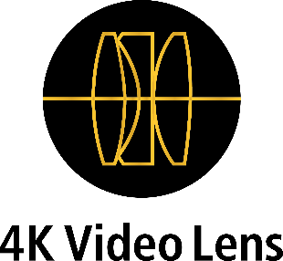
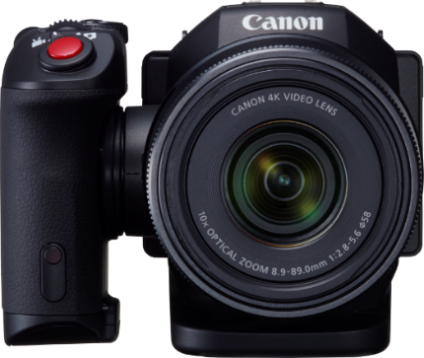
Compact and discrete 4K UHD video with professional audio
Compact and discrete featuring 4K UHD/Full HD internal video recording with professional XLR audio that is easy to use, with footage that can be seamlessly integrated with other professional Cinema EOS cameras.
Capture professional 4K and Full HD video
Professional XLR audio connections
Professional features and easy workflow integration
Discrete and highly versatile
Easy to use
Product Range
Canon XC15
Canon XC10
Canon XC15
Canon XC10

Slide 2
Technical Specifications
Technical Specifications
Camera
Image Sensor
Sensor | 1.0 Type CMOS
System | Bayer pattern filter
Total pixels per sensor | 13.36 MP (4224 x 3164)
Effective pixels per sensor | Video Mode: approx. 8.29 MP (3840 x 2160); Stills mode: approx.12 MP (4000 x 3000)
Minimum illumination | AUTO MODE: PAL 50.00i: Approx. 5.32 lux (at 1/50 sec. shutter speed) 25.00P: Approx. 2.68 lux (at 1/25 sec. shutter speed) Manual Mode, PAL 50.00i/25.00P: Approx. 0.05 lux (shutter speed 1/2 sec.)
Horizontal Resolution | 1700 lines or more (4K Recording), 900 lines or more (Full HD recording)
Lens
Zoom ratio | 10x optical
Focal length | Video Mode: 8.9 – 89 mm (27.3 - 273 mm, 35 mm equivalent) Stills Mode: 4:3 - 24.1- 241mm,/ 3:2 - 25 – 250 mm, / 16:9 - 27.3 – 273 mm (approx.)
Minimum focus distance | 50 cm across entire zoom range; approx. 8 cm at wide macro setting
ND filter | Yes, single density built-in. 1/8 (3-step) equivalent
Zoom control | Manual. 35 mm conversion markers provided
Focus control | AF, Face detection and tracking, Push AF, AiAF (Photo Mode) Manual focus ring Touch Focus Function.
Iris control | Auto, manual via control wheel
Aperture range | f/2.8 - f/5.6 (W-T)
Filter diameter | 58 mm
Lens elements/groups | 12 Groups of 14 elements
Aperture blades | 8 blade diaphragm. Mechanical shutter built in.
Image stabilization system | Optical (lens shift) + electronic stabilisation. Movie Mode IS options: Dynamic IS¹, Standard IS, Powered IS
Digital zoom | No Digital Zoom. 2 x Digital Teleconverter via assignable button
Image Processor
Type | DIGIC DV 5
Sampling accuracy | YCC 4:2:2 (4K or Full HD, XF-AVC/MXF)
Bit depth | 8-bit
Recording
Video storage media | 4K: CFast 2.0™ card, VPG130 supported. Full HD/Photo: SD card (Class 10 recommended for 50Mbps)
Capacity | Depends on card used
Recording time | Depends on card capacity. 4K: CFast 2.0™ 64 GB approx. 25 min @305 Mbps. Full HD 64GB SD card approx. 170 min @50 Mbps
Recording file format | Material eXchange Format (MXF)
Recording format | Video Format: XF-AVC. Compression Format: MPEG-4 AVC/H.264
Recording frame rate (PAL model) | Cfast 2.0™ Card: 4K(3840 x 2160) Recording; 25.00P/24.00P (305Mbps or 205Mbps) Full HD Recording (1920 x 1080) 50Mbps: 50.00P; 35Mbps at 50.00i/25.00P/24.00P HDMI Out: 4K(3840 x 2160) Recording; 25.00P/24.00P (305Mbps or 205Mbps) Full HD Recording (1920 x 1080) 50Mbps: 50.00P; 35Mbps at 50.00i/25.00P/24.00P 1280 x 720: 50/35 Mbps; 100P
Slow/Fast motion | Yes: 1/4x - 1200x speed ¹. Frame rate 25.00P
Interval Record | Yes, Photo Mode only
Frame Record | No
Pre Record (cache record) | Yes, in Full HD mode to SD card only. 5 Second pre-record time
Scan Reverse | No
HD->SD conversion | No
Internal Data Transfer | No
Photo storage media | SD card
Still Image quality | 8.29 – 12 Mp depending on format
System
Monitor Panel
Monitoring Panel Type | Capacitive touch screen LCD
Size | 3-Inch /7.66cm
Dots | approx. 1,030,000
Image quality adjustments | Brightness, Backlight
Adjustable | Yes. 2-axis parallel hinge mechanism
Waveform Monitor | Yes
View Assist Function | Yes, when High Brightness Priority selected in CP menu
Focus Assist | Magnification. Area selectable via touch screen
Peaking | Yes, Red, blue or yellow selectable
Zebra | Yes. 70% or 100%, selectable
Markers | Yes. Horizontal or grid markers white or grey
EVF
Size | No EVF. Optical loupe viewfinder attachment for LCD screen supplied
Inputs/Outputs
Audio in | Built-in stereo microphone, 3.5 mm stereo mini jack external microphone, 2 x XLR via Microphone Adapter MA-400
Audio Connection | Canon 13-pin connector for Microphone Adapter MA-400
Headphone output | 3.5 mm Stereo mini jack
Video monitor output | No
HDMI | Yes. Output only
HDMI Video Output (Playback Mode) | PAL 4K movie playback : 3840x2160/25.00P :1920x1080/50.00P/50.00i 720x576/50.00P HD movie playback: 1920x1080/50.00P/50.00i 720x576/50.00P
USB | Yes mini-B, Hi-speed, Output only
HD/SD-SDI output | No
Time code | Yes, via HDMI
Genlock | No
Component out | No
AV terminal | No
DC input | Yes
Remote Control Terminal | No
Colour Bars | Yes. PAL Model: EBU/SMPTE. Can be output via HDMI
Misc
Tally lamp | Yes
Accessory shoe | Yes, Coldshoe
Custom key | No
Custom Dial | No
Shooting functions
Exposure
Exposure metering | Movie mode: Standard, spotlight, backlight Photo mode: Evaluative, centre-weighted, spot
Exposure compensation | -2.0 - +2.0 stops in 1/3 stop increments (photos) and 1/4 stop increments (movies)
Custom Picture Settings | Video Mode: Standard, Cinema EOS Std., Neutral, Production Camera, Color Matrix off, Canon Log, EOS Std., Wide DR, Cinema EOS Std., high-brightness priority, user settings (1/2) Photo Mode: Standard, Portrait, Landscape, Neutral, Fidelity setting, Sepia, Monochrome, Clear, Autumn Leaves, user settings (1/2)

Slide 3
Technical Specifications
Auto Exposure mode | AUTO/Programmed AE (P)/Shutter-priority AE (Tv)/Aperture-priority (Av) / Manual Exposure (M)/SCN (Portrait /Sports /Night Scene /Snow /Beach /Sunset /Low Light / Spotlight / Fireworks)
Exposure Lock | Yes (in compatible modes)
Auto Gain Control setting | Yes.
Auto Gain Control limit | 28.5 dB
ISO Sensitivity | Movie /Photo: ISO 160 - 20000 Movie Mode with Canon Log or Wide DR selected: 500 to 20000
Gain setting | 0.0 - 42.0dB At the fine gain setting: Any setting in a 0.5 increment between 0.0 dB and 42.0 dB Movie Mode with Canon Log or Wide DR selected: 9.0 dB (8.5 dB at fine gain setting) to 42.0 dB
Shutter speed
Control Modes | Manual, Shutter Priority AE (Tv), Auto Slow Shutter On/Off
Shutter speed | Movie Mode: 1/2, 1/3, 1/4, 1/5, 1/6 to 1/2000 sec. (in 1/4-step increments) Photo Mode: 0.5 sec., 0.4 sec., 0.3 sec., 1/4 - 1/2000 sec. (in 1/3-step increments)
Shutter Angle | Yes
Slow Shutter (SLS) | Yes
Clear Scan | No
Infrared
Infrared shooting mode | No
Built-in IR lamp | No
Wi-Fi & GPS Specifications
Wireless LAN standards | IEEE 802.11b/g/n (2.4GHz band) / IEEE 802.11a/n (5GHz band* ) *5GHz band not available in Qatar
Supported Wi-Fi Functions | Photo Mode: Playback (in browser) from SD card; Download and save images to user terminal device via web browser.
Supported Browser for Remote Operation | Internet Explorer, Safari (iOS), Safari (Mac OS), Android standard browser
Remote Operation Control Features | Aperture, Focus, WB, Shutter Speed, ISO/Gain, Shooting Mode, Start/Stop Recording
Live view image Resolution | Camera setting mode: 680 x 383; Simplified setting: 284 x 160
Authentication Systems | Open/WPA-PSK/WPA2-PSK
Encryption | WEP64, WEP128, TKIP, AES
GPS Information (Optional Accessory) | Latitude/Longitude/Elevation, Coordinated Universal Time (UTC)
White balance
Auto | YES
Preset | 6 Presets: Daylight, Shade, Cloudy, Tungsten (incandescent lamps or halogen bulbs), Fluorescent H (3-wavelength type fluorescent), Fluorescent (white fluorescent)
Shockless WB | Yes
Manual setting | Set 1, Set 2 (Default 5,500K)
Time Code
Countup system | Regen/Rec Run/Free Run/Preset (Non-Drop Frame)
Start value setting | “00:00:00:00”, Set/Reset selectable
Audio
Recording | Linear PCM (2ch, 16 bit, 48 kHz)
Audio Settings (Movie Mode) | Built-in Mic Wind Screen: Auto High/Auto Low/Off Internal mic attenuator: Auto / On / Off Built-in Mic Frequency: Response: Normal, low-range boosting, low-range cutting, mid-range boosting, low and high-range boosting Built-in Mic Directionality: Monaural / Normal / Wide / Zoom: MIC Att. Auto / On / Off : MIC Low Cut. On/Off: Audio limiter, On/Off: Audio compressor: High/Low/Off
Accessories
Supplied | Lens hood, (Loupe) Viewfinder Unit, Microphone Adapter MA-400 , Battery Pack LP-E6N, High Speed HDMI Cable (HTC100/S), Compact Power unit CA-945, Unit Cable UN-5, AC Cable, Interface Cable (IFC-300PCU/S), Shoulder Strap
Optional | Canon Battery Charger LC-E6/LC-E6E, Remote Controller (RC-6) GPS receiver GP-E2, Canon DM-E1 Microphone, Unit Cable UN-5/UN-10 Canon PROTECT Filter 58 mm, Canon ND4-L Filter 58 mm, Canon ND8-L Filter 58 mm, Compact Power Adapter CA-946
Battery
Battery Type | LP-E6N (7.2v,1865 mAh) supplied
Power Consumption | Approx. Max. Recording: 6.0W²/Playback: 4.1W
Continuous Recording Time | Approx.: 110 mins (maximum) / 75 mins(typical)
Miscellaneous
Dimensions | Approx. 128 x 102 x122 mm (body only) Approx. 132 x 221 x 238 mm (with viewfinder unit, MA400 and lens hood)
Weight (camera only) | Approx. 955 g Body Only, approx. 1590 g fully equipped
Weight (fully equipped) | Approx. 1040 g (with lens hood, battery, CFast 2.0™ card and SD card)
Operating Temperature range | Approx. 0°C to 40°C, 85% (relative humidity) Approx. -5°C to 45°C, 60% (relative humidity)
Disclaimers Specifications are given for PAL version of the camera. NTSC version available in appropriate regions
¹ | Dynamic Image Stabiliser not available when recording in 4K or using Slow & Fast Motion mode
² | Depending on capabilities of external recording device in 4K rec. mode 1/4 x and 1/2 x speed not possible to CFast 2.0 ™ card. In Full HD to SD card, 1/4 x rec is 1280 x 720.
³ | In 4K rec. mode 1/4 x and 1/2 x speed not possible to CFast 2.0 ™ card. Full HD to SD card, 1/4 x rec format is 1280 x 720.
All specifications are subject to change without notice
Canon Inc.
canon.com
Canon Europe
canon-europe.com
English edition
Canon Europa NV 2017

Slide 4
Compact and discrete 4K UHD video with professional audio
Compact and discrete featuring 4K UHD/Full HD internal video recording with professional XLR audio that is easy to use, with footage that can be seamlessly integrated with other professional Cinema EOS cameras.
Sales Start Date: September 2016
Product Details:
Product Name | Mercury Code | EAN Code | Recommended Retail Price
Canon 4K Camcorder XC15 (EU) | 1456C003AA | 4549292067125 | <Please fill in RRP>
Optional Accessories:
Product Name | Mercury Code | EAN Code | Recommended Retail Price
Power Adapter CA-946 | 1764C003AA | 4549292084245 | <Please fill in RRP>
Bag SC-2000 | 9389A001AA | 4960999209852 | <Please fill in RRP>
High Speed HDMI Cable HTC-100/S | 2384B001AA | 4960999530383 | <Please fill in RRP>
Unit Cable UN-5 | 0886C001AA | 4549292047950 | <Please fill in RRP>
GPS Receiver GP-E2 | 6363B001AA | 4960999848358 | <Please fill in RRP>
Battery Pack LP-E6N | 9486B002AA | 4549292008302 | <Please fill in RRP>
Remote Controller RC-6 | 4524B001AA | 4960999669304 | <Please fill in RRP>
Battery Charger LC-E6 | 3349B001AA | 4960999627502 | <Please fill in RRP>
Measurement / Logistic Information:
Product Name | Mercury Code | Pack type | Pack description | Quantity per pack | Length (mm) | Width (mm) | Height (mm | Net Weight (kg) | Gross Weight (kg)
Canon 4K Camcorder XC15 (EU) | 1456C003AA | EA | Each | 1 | 330 | 400 | 230 | 3.6
 |  | CT | Carton (Outer) | 2 | 380 | 840 | 280 |  | 7.3
 |  | EP | Euro Pallet | 12 | 1200 | 800 | 990 |  | 53.8
What’s in the box?
Canon XC15 Body
Microphone Adapter MA-400
Unit Cable UN-5
Cable Clamp
Loupe Viewfinder Unit
Battery Pack LP-E6N
Compact Power Adapter
Hood Unit
Lens Cap
Shoulder Strap
USB Cable IFC-300PCU/S
High-Speed HDMI Cable HTC-100/S

